Slide 1

Analyzing the Canadian Industrial Real Estate Market
Understanding the Impact on Vacancy Rates
Group 7

Slide 2
Agenda
Points For Discussion
Introduction
Methodology
Data Audit
Analytical File
Analytical Results / Model Building
Summary of Key Findings

Slide 3
Introduction
Business Problem
Fiera Real Estate’s 2 Business Models:
Buy-Sit-Collect-Rent Strategy: Long lease, single tenant with great credit ie. Amazon Warehouse, collect rent
Value Investing: Purchasing empty land, investing in its development and selling the aforementioned land for a profit.
The Asset Managers at Fiera Real Estate must appropriately select industrial spaces to invest in.
Empty investments are highly undesirable.
Fiera real estate is looking to develop data analytics strategies to be able to invest their capital efficiently.

Slide 4
Key Challenges
Lack of collaboration amongst real-estate firms.
Lack of adoption of data backed business decision making in real estate.
A lot of “gut” decision making
Conventional analytics within the industry make it difficult to build robust business cases due to conditions such as poor data quality or missing information.

Slide 5
Research Objectives
Find or establish a repeatable process relating to the use of data in influencing investment decisions
Identifying & monitoring key indicators to help determine vacancy rates and reduce investment risks

Slide 6
Overview
Explore Historical Trends
Determine variables offering the most predictive power
Using the Predictive Model
Time Series Analysis
Explore historical trends regarding vacancy rates across Canada’s largest Industrial Real Estate markets
6 Variables identified as “best”
Narrow down variables to the ones that offer highest predictive power and construct linear regression model
Model offers direction “where to start looking”
A tool allowing decision makers to stay updated and offer notification on where to focus attention on potential deals

Slide 7
Methodology
Industrial Real-Estate Analysis
Establish the Objective as Minimizing Investment Risk
Build Analytical File
Establish Vacancy Rate as the Target Variable
Determine Predictors associated with the Target Variable
Explore Historical Trends within Vacancy Rate and Analyze Key Variables
Perform Significance Tests for Variables and perform EDA’s
Perform Regression Analysis
Analyze Variable Contribution and Relationship on Target Variable
Provide Insights and Recommendations

Slide 8
Summary of Key Findings of Data Audit
Industrial Real-Estate Analysis
21 Key Variables
Data Provided for Quarters from 1990 to 2020
Most Values Missing from 1990 - 2000
110 Missing Values for Sublease Space - Dropped Variable

Slide 9
Key Findings of Data Audit
Value of Vacant Commercial Real Estate (2020)
City | Avg Value of Industrial Vacant Property
Toronto | $10,566,488.86
Calgary | $4,825,024.53
Halifax | $1,024,694.27

Slide 10
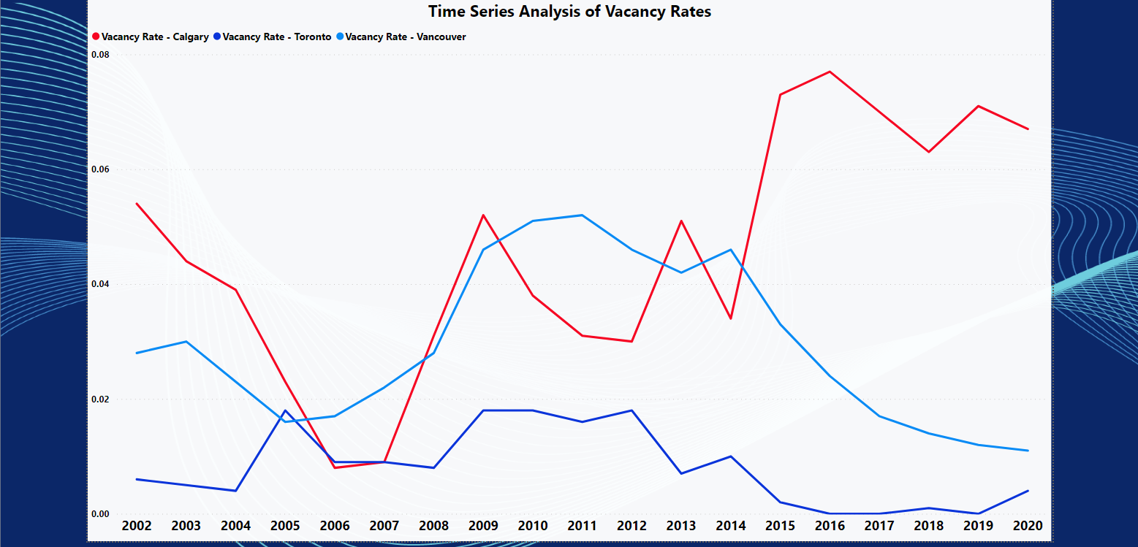
How have Vacancy Rates trended Historically?
Notes:
There is no one size fits all approach

Slide 11
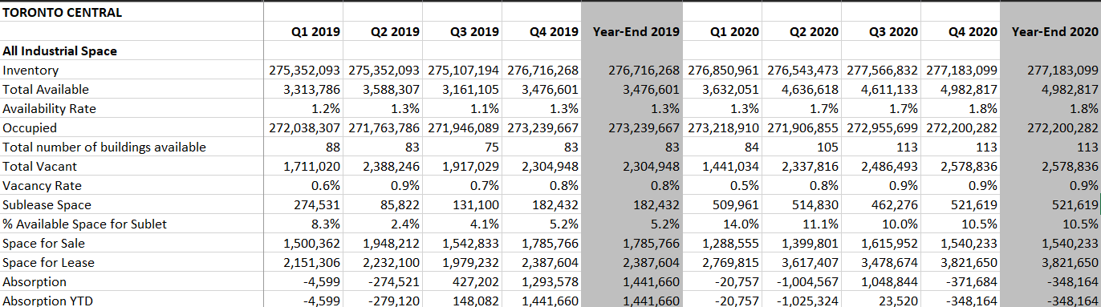
Creation of the Analytical File
Raw Dataset
Notes:
Format Not Suitable for Time Series Analysis
Lots of Null Values for 10 Years worth of Data for Majority Locations
Regression Analysis Not Possible

Slide 12
Creation of the Analytical File
Transformations Applied
Analyze null values and remove rows that have no predictive power (same values for all records)
Transpose dataset
Merge data from different metropolitan areas (merge sheets)
Add new column specifying metropolitan area and region
Add external factor data including GDP, Population, and Inflation Values
Notes:
Analyze null values and remove rows that have no predictive power (same values for all records)
Transpose dataset
Merge data from different metropolitan areas (merge sheets)
Add new column specifying metropolitan area and region

Slide 13
Analyze null values and remove rows that have no predictive power (same values for all records)
Merge data from different metropolitan areas (merge sheets)
Add external factor data including GDP, Population, and Inflation Values
Analyze
Transpose
Merge
Extract Region
Integrate Economics
Transpose dataset
Add new column specifying metropolitan area and region

Slide 14
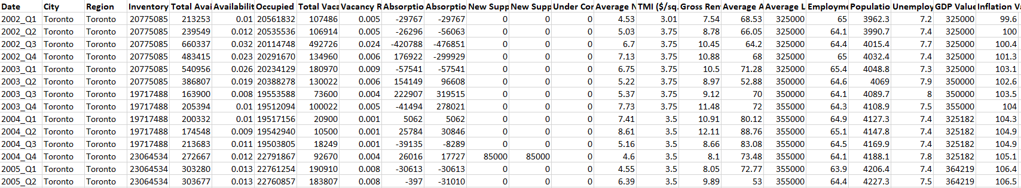
Creation of the Analytical File
Final Analytical File

Slide 15
Initial Correlation Analysis - Vacancy Rate
Correlation Coefficients of Standardised Variables
Standardised Variable | Correlation Coefficient
Total Available | 0.91
Availability Rate | 0.91
Absorption YTD | 0.39
Absorption | 0.29
Inventory | 0.16
New Supply | 0.07

Slide 16
Building the Regression Model - Analytical Results
Our target variable will focus on Vacancy Rate %
After establishing the target variable we need to identify the best Predictor Variables for our regression model
We used backward elimination to narrow the 18 potential predictor variables down to the best.
Identified 6 variables that have been selected as the best for our regression model to predict Vacancy Rate %
These final variables include Total Available Inventory, Availability Rate, Average Asking Sale Price $/sq.ft, Average Land Costs $/Acre, Population (1000’s), Inflation Rate
Establishing Target and Predictor Variables

Slide 17
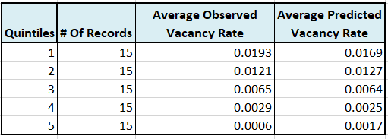
Final Regression Model and Variable Report
FInal Regression Model
Vacancy Rate = 0.0079 + 0.023 * Total Available - 0.017 * Availability Rate - 0.002 * Average Asking Sale Price ($/sq. ft.) + 0.001 * Average Land Costs $/Acre - 0.015 * Population (1000’s) + 0.015 * Inflation Rate
Overall R-Squared and Adjusted R-Squared
R-Squared Score = 0.897 Adjusted R-Squared Score = 0.886
Decile/Gains Chart

Slide 18
Final Regression Model and Variable Report
Variable Report
Variable | % Contribution of Model | Impact On Vacancy Rate
Total Available Inventory | 3% | Negative
Availability Rate | 12% | Positive
Average Asking Sale Price $/sq.ft | 28% | Negative
Average Land Costs $/Acre | 3% | Positive
Population (1000’s) 14% Negative | 14% | Negative
Inflation Rate | 18% | Positive

Slide 19
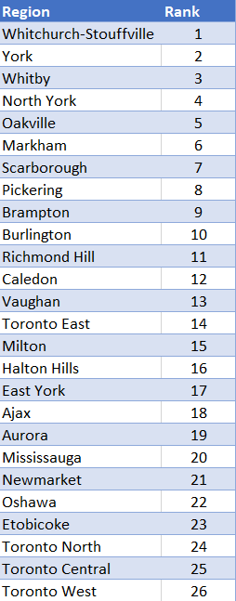
Ranking of Lowest Vacancy Rates in Toronto
Model applied to each region
Metropolitan areas are ranked by their predicted vacancy rates for 2021
Rank prioritizes up and coming regions with potential
Low ranked regions offer risk in terms of predicted vacancy rate for 2021
Well developed regions such as the Toronto’s fall low on the rank

Slide 20
Implementation

Slide 21
Practical Context of Key Findings
York - Industrial space utilised for manufacturing of electronics, incumbent firms in the location include:
Celestica
MIS Electronics
Permatech
Oakville - Industrial space utilised mainly for Advanced Manufacturing, incumbent firms in the location include:
Ford Motor Company of Canada
Collins Aerospace
Dana Corporation
max gwth

Slide 22
Identifying Growth and Potential
Toronto West Market - City of Toronto’s most prominent industrial sector
Pushed Availability rate down 30 basis points to 2% during Q3 2020
From Q2 to Q3 New Supply introduced to market dropped from 2.85MM to 1.22MM sq/ft
6.12MM sq/ft Under Construction
Toronto East Market - Experiencing fast growth in development and potential for investment:
Pushed Availability rate up 10 basis points to 1.7% during Q3 2020
From Q2 to Q3 New Supply introduced to market rose from 58.34K to 260.62K sq/ft
447% increase in supply over one quarter
1.38MM sq/ft Under Construction
max gwth

Slide 23
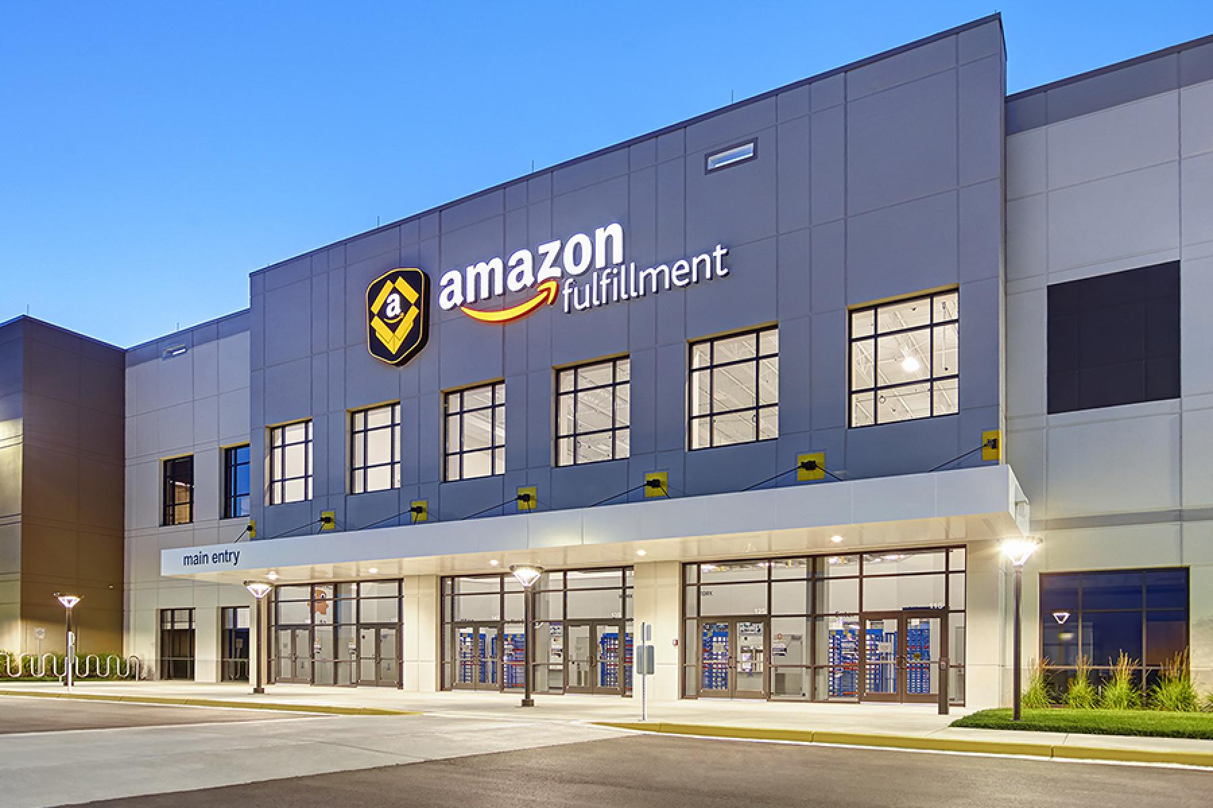
Amazon’s Investment in Toronto East
Amazon signed a design-build deal for a 1.1-million-square-foot automated fulfillment center in the Eastern GTA region
Q3 saw completion of Amazon’s million-square-foot fulfillment centre in Scarborough
Notes:
Investing in areas where Amazon has established operation has become historically lucrative. By following Amazon’s lead and investing in Industrial Space (New Development or Completed Builds) in the Toronto East area, investment is viewed as low risk and leaves room for growth.

Slide 24

Suggestions to Fiera Real Estate
Lead Fiera in the direction to start looking at spaces and cut down decision maker’s pool of options
Allow Fiera to visit the space in person and conduct their due diligence
Data Analytics and our model design gives Fiera an edge

Slide 25
Thank You!

